Slide 1

ENGLISH COMPOSITION AND COMPREHENSION LAB
ORIENTATION CLASS
Week 1 Lecture 1

Slide 2

CONTENT
Course Description
Course Objectives
Marks Distribution
Course Content
LMS for ECC
Reference Books and Resources

Slide 3


COURSE DISCRIPTION
This course is designed to develop skills in speaking, listening, reading and writing, and studying communicative functions of the target language.
Emphasis is on skill acquisition through the use of selected reading material from different banks of authentic and non-authentic texts.
Through understanding the global, inter-relational nature of skills, students are enabled to retain and apply what they have learnt.
It will also orient students to the semantic and socio/psycho-linguistic dynamics of language
3

Slide 4

COURSE OBJECTIVES
The course will acquaint students with more concise, lucid, and correct expression of English; to provide model forms of communication skills with special stress on phonetics and phonology.
The aims are to: achieve proficiency in language use,
develop skills in listening comprehension,
improve reading efficiency,
use the conventions of standard written English with skill and assurance,
build-up vocabulary,
and summarize clearly and accurately the ideas of others etc.
It will illustrate the force and effectiveness of simple and direct English.

Slide 5

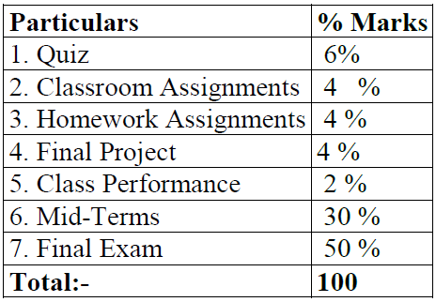
MARKS DISTRIBUTION

Slide 6

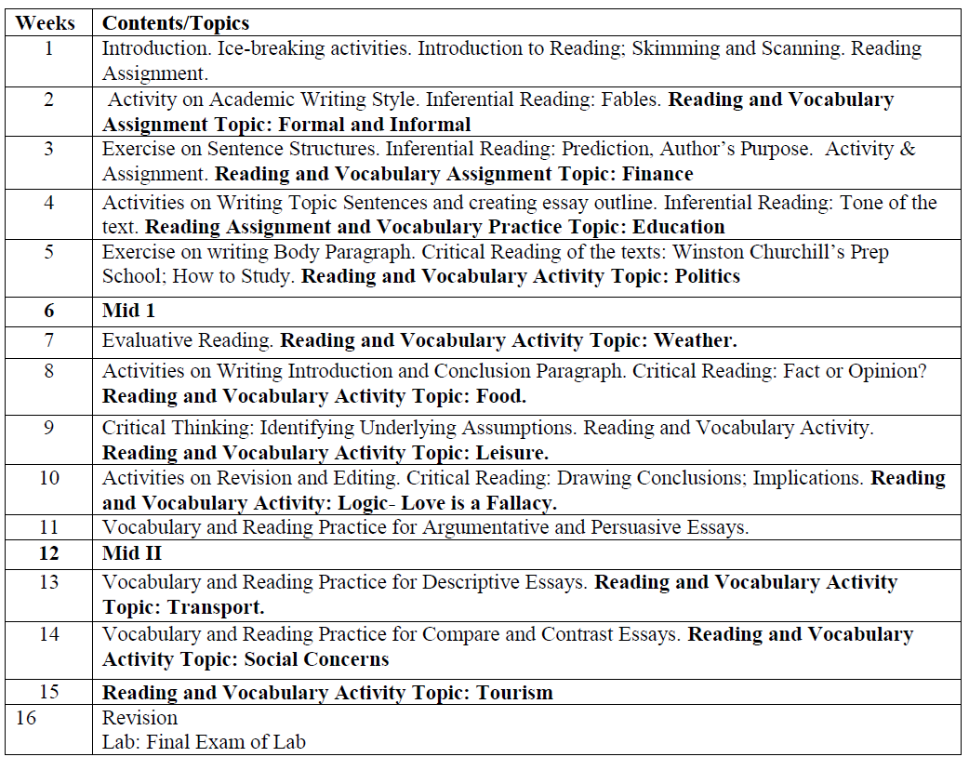

Slide 7


GOOGLE CLASS ROOM ECC LAB (1C) FALL 2020 BSE 1C LAB https://classroom.google.com/c/MTY0MTYyNzUwMjQ4?cjc=uwzuuih
Class code: uwzuuih
7

Slide 8
Reference Books and Resources
College Writing Skills by John Langan, McGraw Hill.
English Vocabulary in use by Michael McCarthy, Cambridge University Press.
Oxford Practice Grammar by John Eastwood, Oxford University Press.
Handout Available at Imtiaz Photostat

Slide 9





THANK YOU
FAIZA MUMTAZ
111-128-128 ( Ext 299)
faiza.mumtaz@nu.edu.pk
Office: EE Building-Top floor-Right corner faculty area, Room no. 5

Slide 10
NOW YOUR TURN! Introduce yourself!

